Slide 1
The Oxford Common File Layout
(OCFL)
https://ocfl.io
Neil Jefferies
Bodleian Libraries, University of Oxford/Data Futures GmbH
neil.jefferies@bodleian.ox.ac.uk
@NeilSJefferies

Slide 2
OCFL is...
an open community effort to
define an application-independent
way of storing
versioned data for
long-term access

Slide 4
Completeness
The data is stored together with its metadata.
Falls in line with standards about preserving access to data.
Allows ease of mapping from one system to another, with the ability to keep a picture of the past.
so that a application can be rebuilt from the files it stores

Slide 5
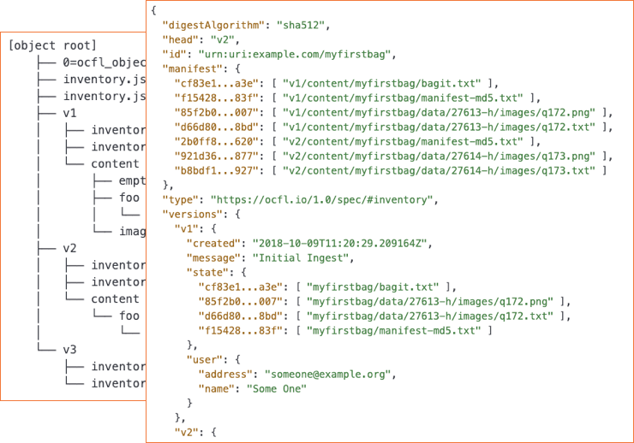
Parsability
In disaster recovery situations, humans should be able to understand the data.
Machine readability allows for simple applications to be placed on top of an existing OCFL storage root.
both by humans and machines, to ensure data can be understood in the absence of original software

Slide 6
Robustness
Strong fixity is built into OCFL.
Data can easily be validated using the inventory.json.
Data can be completely self-contained.
against errors, corruption, and migration between storage technologies

Slide 7
Versioning
Changes to data are tracked over time.
Forward delta is employed to reduce the amount of data stored.
Previous versions of can be reconstructed using the inventory.json file
so applications can make changes to data allowing its history to persist

Slide 8
Storage Diversity
Designed to work with various storage infrastructures including object stores prevalent in cloud offerings (e.g. Amazon S3).
Supports conventional filesystem metaphor.
Can be implemented to ensure deduplication of data, lowering overall storage costs.
to ensure data can be stored on diverse storage infrastructures including cloud object stores

Slide 9
OCFL Status
Release milestones
Alpha 0.1 - Oct 2018
Alpha 0.2 - Feb 2019
Beta 0.3 - Jun 2019
Release 1.0 - July 2020
Release criteria
1.0 Validator ✔
Test suite ✔
Fixture objects ✔
Two institutional commitments ✔

Slide 10
Who is investing in OCFL?
Tools
Johns Hopkins University - Go client
Cornell University - Python client, validator, and test suite
Penn State - Go client
University of Wisconsin, Madison - Java client
Stanford - Ruby client, validator, and test suite
University of Technology, Sydney - Javascript client
Brown University - Clojure HTTP server

Slide 11
Who is investing in OCFL?
Systems
University of Technology, Sydney - Research Data Portal
Pacific & Regional Archive for Digital Sources in Endangered Cultures - Catalog
University of Cologne - Analysis and Archiving of Audio-Visual Data
LYRASIS - Fedora Repository
Data Futures - hasdai Network

Slide 12
Watching
https://groups.google.com/forum/#!forum/ocfl-community
https://ocfl.io/ -- latest release and live current drafts
Jumping in
Monthly calls announced on ocfl-community Google Group
Join us on Slack (channel #ocfl)
Review and contribute use cases.
Review spec & implementation notes, discuss and submit issues
Implement and share your experiences

Slide 13
Thank you
Neil Jefferies
Bodleian Libraries, University of Oxford/Data Futures GmbH
neil.jefferies@bodleian.ox.ac.uk
@NeilSJefferies

